Slide 1

Sentiment Analysis of Movie Reviews
Explore how natural language processing (NLP) unlocks emotions in movie reviews. Gain insights into audience feelings and critical reception to enhance film marketing and recommendations.

Slide 2
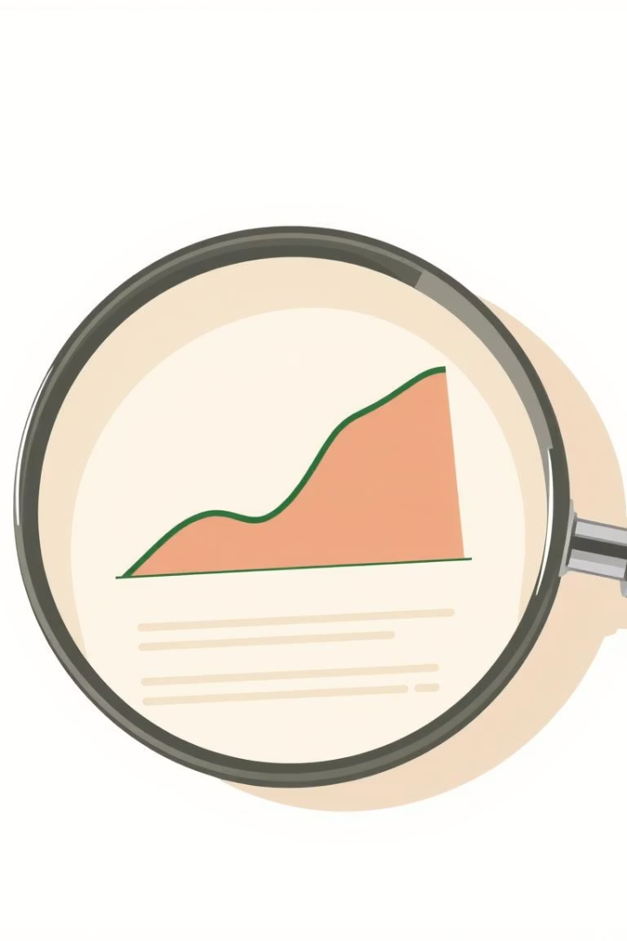
Introduction to Sentiment Analysis
What is Sentiment Analysis?
Classifying opinions into positive, negative, or neutral categories.
Techniques
Rule-based approaches
Machine learning models
Deep learning algorithms
Applications
Online feedback, brand monitoring, market research insights.
Example
The phrase "This movie was amazing!" is positive sentiment.

Slide 3
Applying Sentiment Analysis to Movie Reviews
Why Movie Reviews?
Sources
Use Cases
Examples
Rich data volume and diverse opinions enhance model training.
IMDb, Rotten Tomatoes, Metacritic
Predicting box office trends, tailoring audience recommendations.
Detecting positive buzz or critical negativity in reviews.
Social media like Twitter

Slide 4

Data Collection and Preprocessing
Dataset
1
50,000 IMDb movie reviews collected for training.
2
Cleaning Steps
Remove HTML tags, punctuation, special characters
Tokenize text into words
Purpose
3
Remove stop words and apply stemming
Prepare data for accurate and efficient analysis models.

Slide 5

Methodology and Models
1
Data Acquisition
2
Preprocessing
3
Feature Extraction
4
Model Training
5
Evaluation
6
Visualization
Using logistic regression with TF-IDF features and multiple metrics for evaluation including accuracy and F1 score.

Slide 6
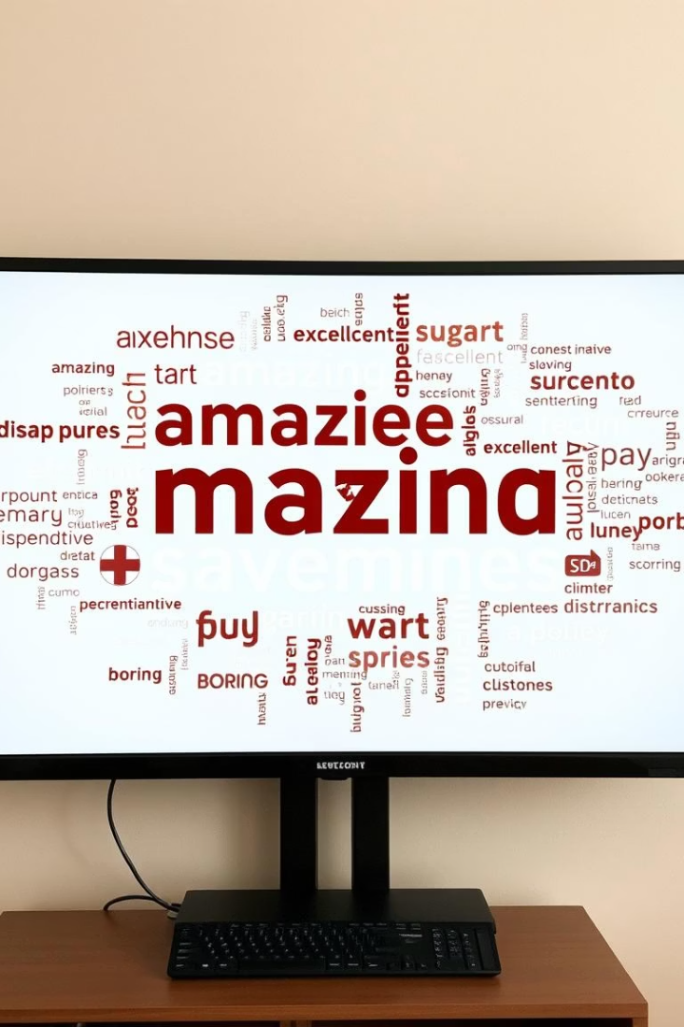
Results and Findings
Model Accuracy
Positive Keywords
BERT model achieved 92% classification accuracy.
amazing
brilliant
fantastic
masterpiece
Negative Keywords
awful
terrible
boring
predictable

Slide 7
Challenges and Limitations
Sarcasm & Irony
Context Sensitivity
Data Bias
Domain Specificity
Hard to detect sarcastic comments that change sentiment.
Understanding sentiments requires analyzing surrounding text.
Reviews may be skewed toward more positive or negative views.
Models need adjustments for different movie genres and styles.

Slide 8

Conclusion and Future Directions
Enhance Models
Integrate reviewer metadata like age and location.
Multimodal Analysis
Include trailers, images, and videos alongside text.
Real-time Sentiment
Analyze audience reactions during screenings live.
Personalized Recommendations
Tailor movie suggestions by sentiment preferences of users.

